Slide 1
Customer Retention for an Online Store

Slide 2
COUSTOMER RETENTION
Customer retention is the practice of keeping existing customers engaged and loyal to a business through strategies that encourage repeat purchases and prevent them from switching to competitors.

Slide 3
DATA COLLECTION
Process: Gathering and organizing customer data
Sources: CRM system, web analytics tools, customer support system, email marketing platform
Importance: Crucial for predicting customer churn and developing retention strategies

Slide 4

DATA SOURCES
CRM System: Customer information and purchase history
Web Analytics Tools: User behavior and engagement metrics
Customer Support: Support tickets, resolution time, customer feedback

Slide 5
TYPES OF DATA COLLECTED
Customer Information: Customer ID, age, gender, location, income level, account creation date
Purchase History: Transaction ID, purchase date, items purchased, purchase amount
Engagement Metrics: Frequency of visits, time spent on site, pages viewed, interactions
Customer Support: Support tickets, resolution time, customer feedback
Marketing Interactions: Email opens, click-through rate, promotion usage

Slide 6
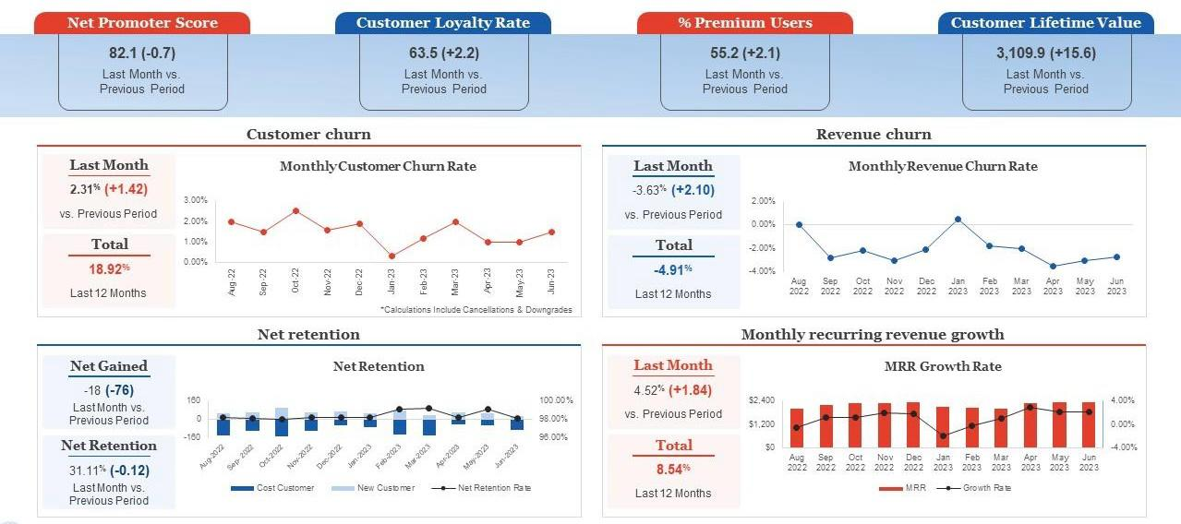

Slide 7
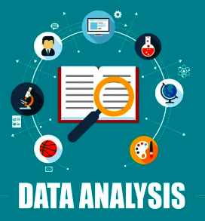
DETAIL DATA ANALYSIS
Net Promoter Score (NPS): 82.1 (-0.7)
Indicates customer loyalty and likelihood to recommend the store.
Customer Loyalty Rate: 63.5 (+2.2)
Percentage of customers who remain loyal.
Percentage of Premium Users: 55.2 (+2.1)
Proportion of users subscribed to premium services.
Customer Lifetime Value (CLV): 3,109.9 (+15.6)
Total revenue expected from a customer over their lifetime
Customer Churn Rate:
Last Month: 2.31% (+1.42)
Total (Last 12 Months): 18.92%
Revenue Churn Rate:
Last Month: -3.63% (+2.10)
Total (Last 12 Months): -4.91%
Net Retention:
Net Gained: -18 (-76)
Net Retention Rate: 31.11% (-0.12)
Monthly Recurring Revenue (MRR) Growth:
Last Month: 4.52% (+1.84)
Total (Last 12 Months): 8.54%

Slide 8
DATA PREPROCESSING STEPS
Data Cleaning: Remove duplicates, handle missing values, ensure data consistency
Feature Engineering: Average purchase value, recency (time since last purchase), frequency (number of purchases), monetary value (total amount spent)
Data Splitting: Split data into training and testing sets

Slide 9
CUSTOMER SEGMENTATION
Criteria: Customer Loyalty Rate, Percentage of Premium Users, Customer Lifetime Value
Method: K-means clustering to group customers into categories (e.g., high-value, frequent shoppers, at-risk customers)
Visualization: Show a chart or graph illustrating different customer segments

Slide 10
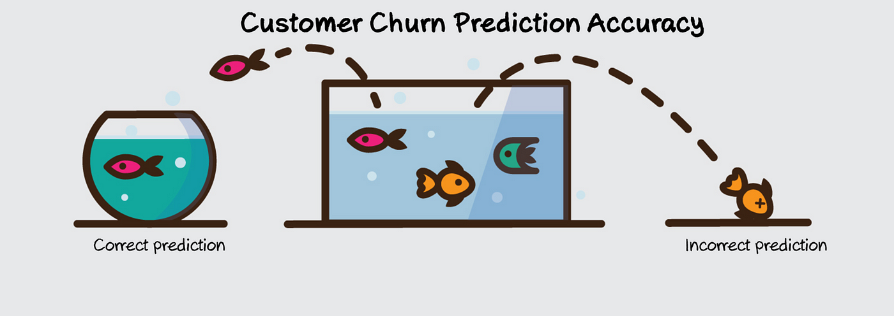
CHURN PREDICTION MODEL
Feature Selection
NPS, Loyalty Rate, Premium Users, CLV, Engagement Metrics.
2. Model Training
Algorithms: Logistic regression, random forests.
Data: Historical customer data
3. Model Evaluation
Metrics: Accuracy, precision, recall, F1-score.
4. Model Interpretation
Identify key churn factors for targeted retention strategies.
GRADIENT BOOSTING MODEL:A Gradient Boosting model for customer retention predicts which customers are likely to churn by sequentially correcting errors from previous models, enabling targeted retention strategies such as personalized offers and improved customer service.

Slide 11

STRATEGIES FOR CUSTOMER RETENTION
Personalized Offers
Targeted discounts for high-risk customers
2. Loyalty Programs
Rewards for frequent shoppers.
3. Improved Customer Service
Quick issue resolution.
4. Engagement Strategies
Re-engage inactive customers.
5. Regular Communication
Keep customers informed.

Slide 12
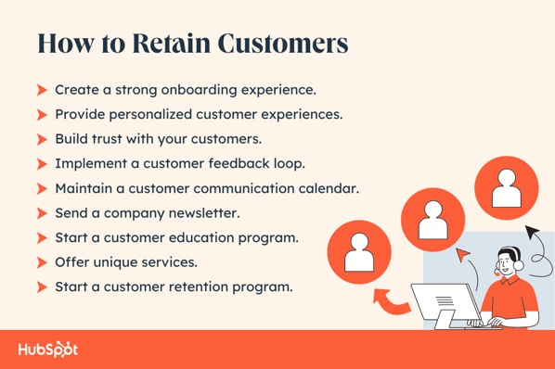
PERSONALIZED RETENTION STRATEGIES
1. Personalized Discounts
Targeted discounts based on purchase history.
2. Loyalty Programs
Rewards for frequent shoppers.
3. Exclusive Access
Early access to new products and sales.
4. Improved Customer Support
Fast and effective issue resolution.
5. Personalized Communication
Tailored emails and messages.

Slide 13
CONCLUSION
Summary
Predicted customer churn using data and machine learning.
Identified at-risk customers with key metrics.
Impact
Implemented personalized retention strategies.
Increased satisfaction and reduced churn.
Future Steps
Continuously monitor and refine strategies.

Slide 14
Thank you

